Slide 1
Module 6: Overview of spatial modeling
Michael Otterstatter, PhD
Analytic Capacity Building Initiative: Workshop in Geospatial Methods
September 17-18, 2019, Calgary, Alberta

Slide 2
Outline
Background and concepts
purpose of spatial modeling
types spatial regression models
structure of spatial regression models
applications of spatial regression models
References and other resources

Slide 3
Background and concepts

Slide 4




Purpose of spatial modeling
Background and concepts
Often, we wish to understand how various types of spatial information are related
outcomes
population size
individual and population characteristics
environmental exposures

Slide 5
Purpose of spatial modeling
Background and concepts
Spatial modeling provides statistical tools for
assessing how spatial distribution of health events is associated with the spatial distribution of exposures
adjusting maps and other visualizations according to available covariate information
predicting outcomes of interest based on available covariates
Here, we review only selected concepts in spatial modeling but do not cover technical aspects of model building and validation

Slide 6
Types of spatial regression models
Background and concepts
A primary type of spatial model is the spatial regression model, which adds key spatial elements to non-spatial regression models:
adjacency (neighbourhood relationships)
spatial correlation
Spatial regressions include the primary model types used in non-spatial analysis
general linear models (ordinary linear regression)
generalized linear models (Poisson and logistic regressions)

Slide 7
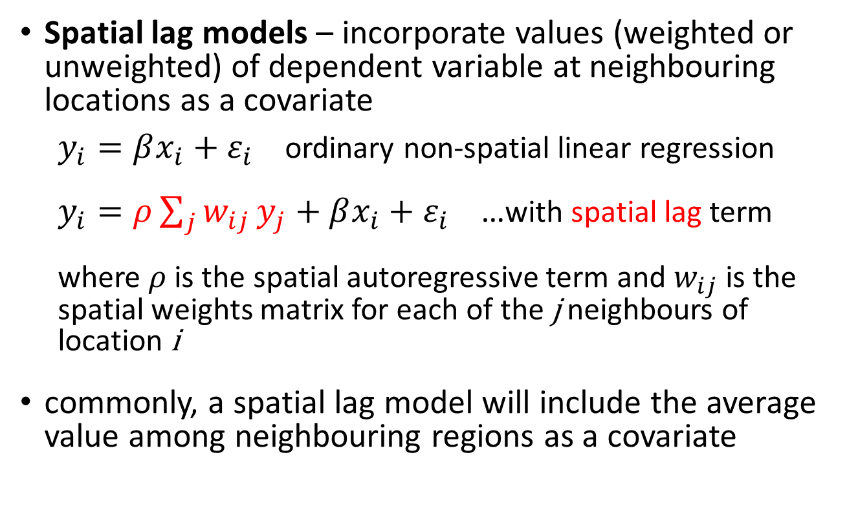
Structure of spatial regression models
Background and concepts
Spatial lag models – incorporate values (weighted or unweighted) of dependent variable at neighbouring locations as a covariate
$y_{i}=βx_{i}+ε_{i}$ ordinary non-spatial linear regression
$y_{i}=ρ\sum_{j}{w_{ij}}y_{j}+βx_{i}+ε_{i}$ …with spatial lag term
where $ρ$ is the spatial autoregressive term and $w_{ij}$is the spatial weights matrix for each of the j neighbours of location i
commonly, a spatial lag model will include the average value among neighbouring regions as a covariate

Slide 8
Structure of spatial regression models
Background and concepts
Spatial lag models are useful as regressions that account for spatial autocorrelation (by filtering out the spatial autocorrelation among neighbours)

Slide 9
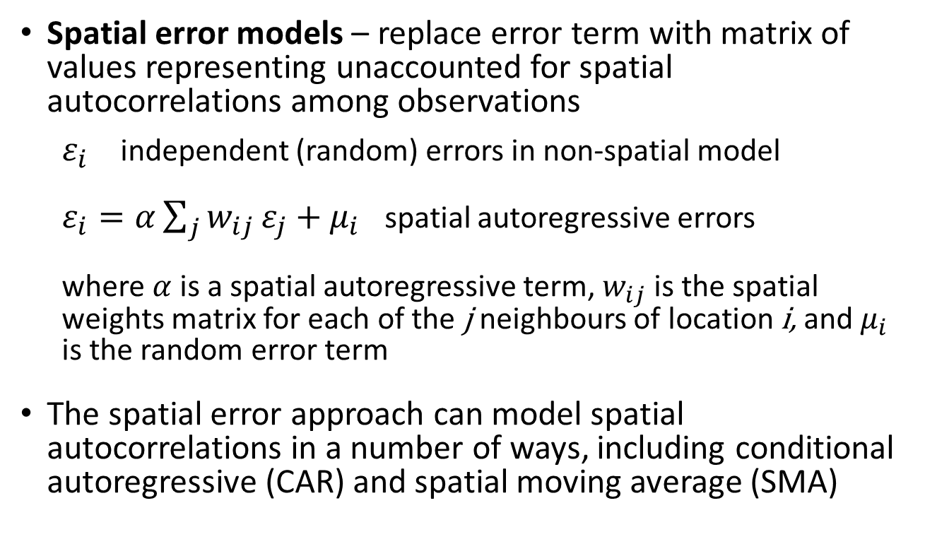
Structure of spatial regression models
Background and concepts
Spatial error models – replace error term with matrix of values representing unaccounted for spatial autocorrelations among observations
$ε_{i}$ independent (random) errors in non-spatial model
$ε_{i}=α\sum_{j}{w_{ij}}ε_{j}+μ_{i}$ spatial autoregressive errors
where$α$is a spatial autoregressive term, $w_{ij}$is the spatial weights matrix for each of the j neighbours of location i, and $μ_{i}$ is the random error term
The spatial error approach can model spatial autocorrelations in a number of ways, including conditional autoregressive (CAR) and spatial moving average (SMA)

Slide 10
Structure of spatial regression models
Background and concepts
Spatial autoregressive models can be implemented in R using the spdep package, similar to ordinary linear models with the lm function in base R
lm(events ~ var1 + var2, data = my_data)
lagsarlm(events ~ var1 + var2, data = my_data, listw = my_spatial_weights)

Slide 11
Applications of spatial regression models
Background and concepts
Disease mapping, adjusted for covariates (e.g., population size and structure)
Risk assessment – identifying areas of unusually high or low rates, given background distribution of covariates (e.g., sociodemographics)
Stabilization/interpolation of rates for areas with small counts or missing values
Spatial epidemiology – identifying and understanding causal (or at least associational) relationships, e.g., key drivers of spatial distribution of health events
Others?

Slide 12

Considerations and cautions
Background and concepts
It is important to conduct standard diagnostic tests of model assumptions (e.g., analysis and plotting of residuals) for spatial regressions, plus inspection of spatial patterns in residuals
Covariates in spatial regression models must be interpreted carefully – spatial variation in an outcome may be due to spatial variation in predictors and/or inherent spatial variation in the outcome itself

Slide 13
References and resources
Banerjee, S., 2016. Spatial data analysis. Annual Review of Public Health, 37: 47-60.
Fotheringham, A.S. and Rogerson, P.A., eds. 2008. The SAGE handbook of spatial analysis. Sage.
Waller, L.A. and Gotway, C.A. 2004. Applied spatial statistics for public health data. John Wiley & Sons.

